Slide 1
BlueStone Realty Inc.
Business Intelligence Analysis
on House Prices
Technical Presentation
Springboard Data Analytics
Capstone - 2
Date : 7/18/2020
Presented By : Huseyin Korkmaz

Slide 2
The yearly actual revenue is $4M less than the budget revenue as of July 2010. It is necessary to increase the revenue by at least 16% with respect to the budget of $25M until the end of the year. Remodeling houses before selling them can be an effective strategy to have more revenue opportunities.
!
While June and July are the months in which most houses are sold, this period of 2010 is `the worst June and July ever' for BlueStone. Despite the monthly sale price is $10.8M in June 2009, it is $6.5M in June 2010. As of July 2010, BlueStone's actual revenue is $4M behind budget revenue.
Actual revenue is $4M behind the budget revenue
!
In order to catch the revenue of 2009, BlueStone should reach the target of $29M revenue in the remaining 5 months of the year by increasing its $25M budget revenue by at least 16%.
To increase the revenue by at least 16% is necessary
!
The sooner the remodeling the higher the value of the house. Actions should be taken to have more revenue opportunities by determining the top houses which are expected to provide the most revenue opportunities in the case of the remodeling them.
Remodeling houses can be
an effective business strategy

Slide 3
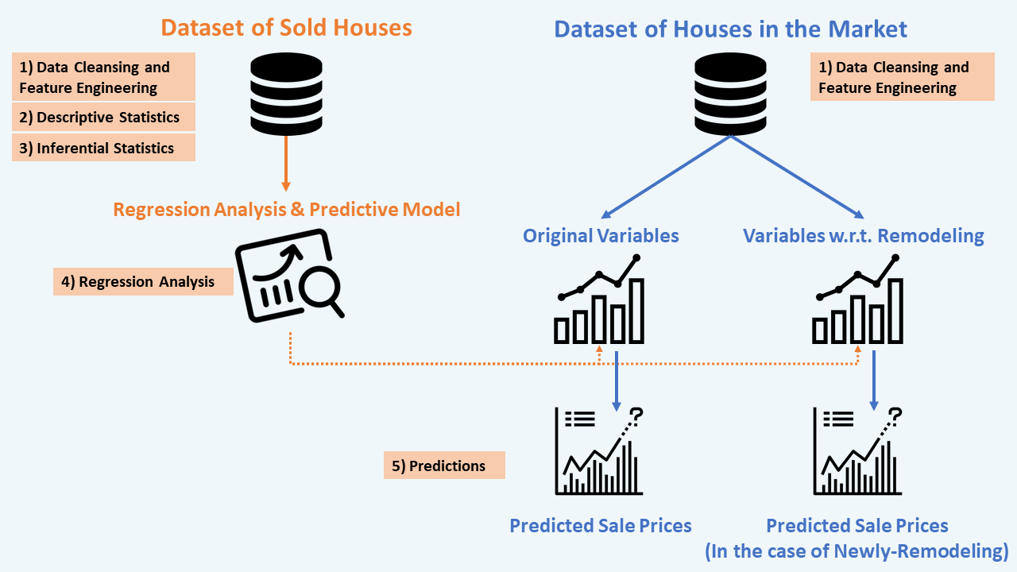

By analyzing features of sold houses and then using regression analysis and predictive model, it is possible to identify the top houses in the market and calculate that if we sell these target houses by remodeling them, how much more revenue we will gain.
Compare
Number of Variables
(After Feature Engineering)
42 Categorical variables
41 Numerical variables
Feature Engineering: For the more accurate analysis, while we added some features such as 'Total Sq Footage’, 'House Age’, ‘Remodeled’, and ‘Newly-Remodeled’, we transformed some variables that have some missing values.
Statistical Analysis: We applied descriptive and inferential statistical analysis to have a better understanding of the features involved in our data and especially focused on the features that have the highest correlation towards Sale Price.
Regression and Predictive Model: We implemented regression analysis and predictive model on the data of sold houses with an average accuracy of 81%, then applied the same model on the data of houses in the current market to see the predicted sale prices.
Source: Ames, Iowa Housing Data (Kaggle)

Slide 4
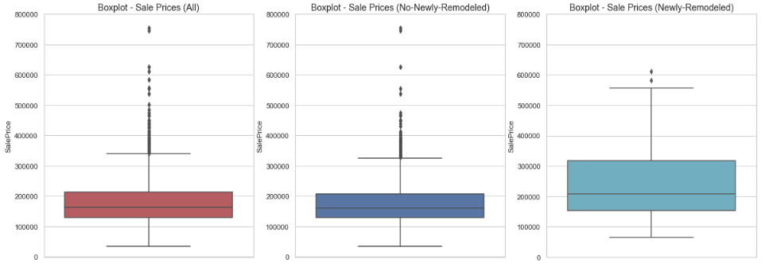
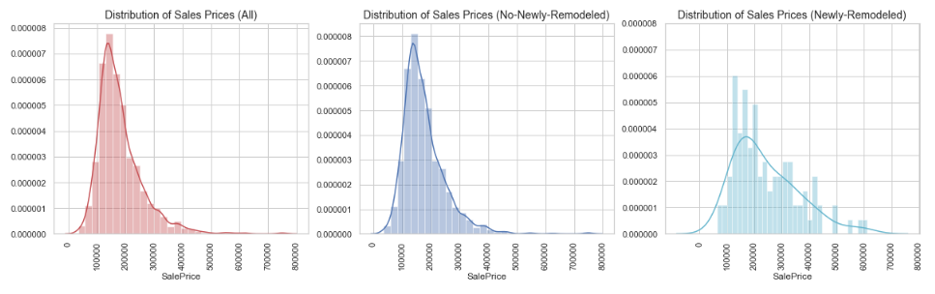
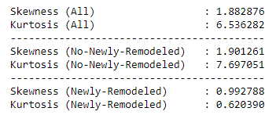
To understand the effect of remodeling houses before selling them, we split the data into two respective sets indicating newly-remodeled houses and others and compared the sale prices.
What does it mean
Newly-Remodeled House?
If a house was remodeled one year or less time before it was sold, it shows this house was remodeled for sale. We will call these houses Newly-Remodeled.
We will call other houses as Others or Non-Newly-Remodeled which weren't remodeled or were remodeled more than one year before sales.
Source: Ames, Iowa Housing Data (Kaggle)

Slide 5
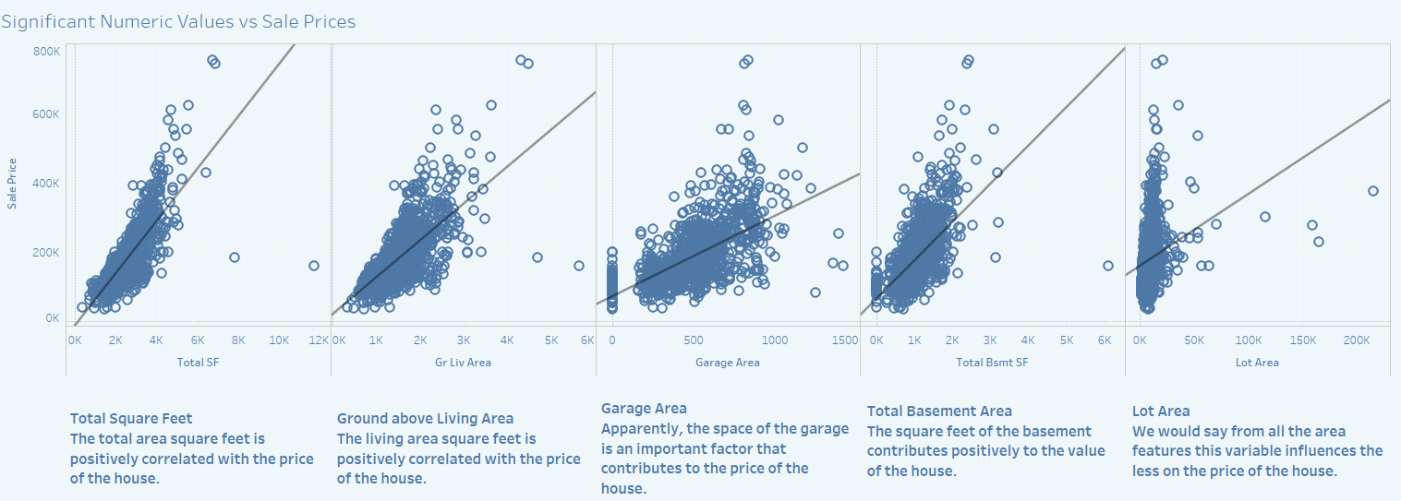
The top variables with the most predictive strength are Overall Quality, Total Area, Ground above Living Area, Garage Area, Total Basement Area, and Lot Size which are further reinforced by the scatter plots below.
Overall Quality, Total Area, Ground above Living Area, Garage Area, Total Basement Area, and Lot Size are the top variables that have a strong relationship with Sale Price.
Source: Ames, Iowa Housing Data (Kaggle)

Slide 6
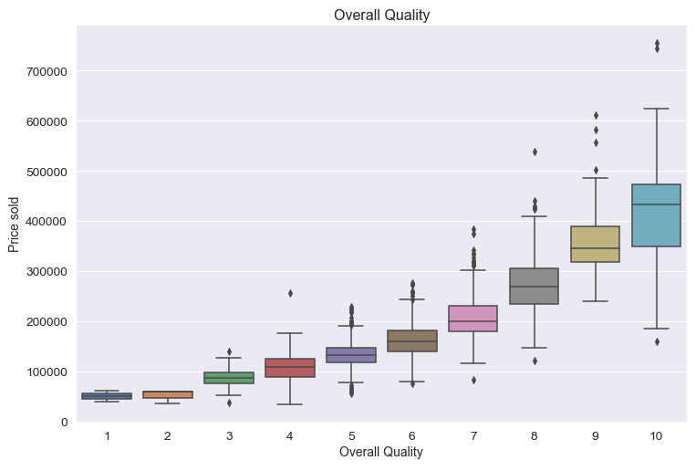
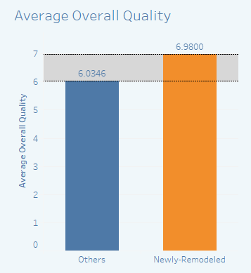
Our analysis shows that the quality of the house is one of the factors that mostly impacts Sale Price. There is almost 1-point difference between the quality of houses newly-remodeled and others. Moving the quality of a house to the next level by remodeling it can increase its Sale Price.
Source: Ames, Iowa Housing Data (Kaggle)

Slide 7
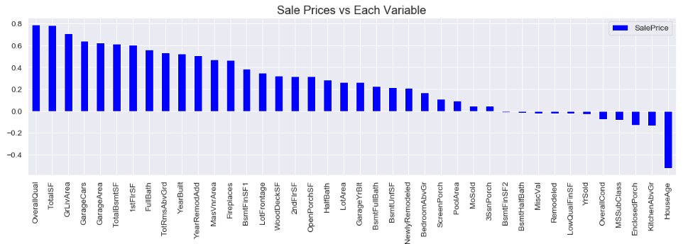
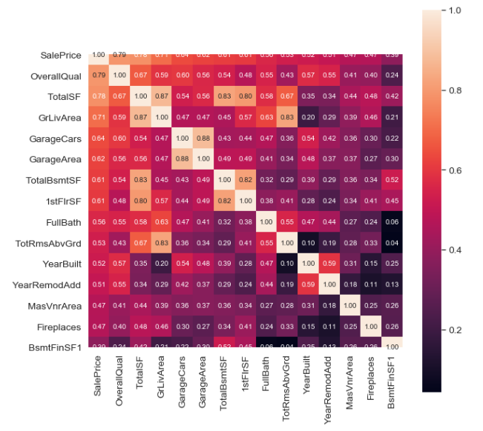
We chose numerical features to see if they are strong predictors of housing prices. There are a relatively positive linear relationship between Sale Price vs 'OverallQual', 'TotalSF', 'GrLivArea', 'GarageCars', 'GarageArea', 'TotalBsmtSF', '1stFlrSF', 'FullBath', 'TotRmsAbvGrd’, 'YearBuilt', and 'YearRemodAdd'.
Expanding on initial insights from descriptive statistics, this was further reinforced with our Pearson-Correlation which came to a similar conclusion highlighting OverallQual, TotalSF, GrLivArea, GarageArea, TotalBsmtSF, 1stFlrSF, FullBath, TotRmsAbvGrd, YearBuilt, and YearRemodAdd as strongly (>0.5) correlated with Pump Failure.
Note: Pearson’s Correlation was calculated for each of the variables.
Source: Ames, Iowa Housing Data (Kaggle)

Slide 8
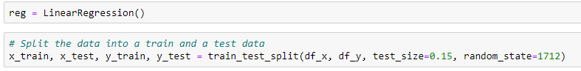
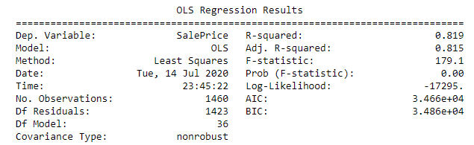
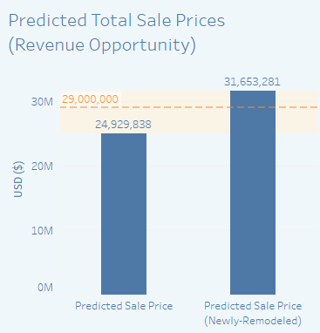
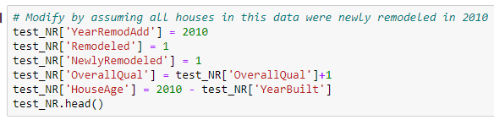
We implemented regression analysis and predictive model on the data of sold houses with an average accuracy of 81%, then applied the same model on the data of houses in the current market to see the predicted sale prices.
Implementing Regression Analysis and Predictive Model on Sold Houses
We randomly split all numeric variables into a train (85%) and a test data (15%).
With an average accuracy of 81%, the improved pricing predictive model can be utilized to estimate the sale prices of houses in the current market.
Implementing The Same Model on Houses in the Market
To see the sale price difference in the case of remodeling, we copied dataset of houses in the market, then modified one of them by assuming the houses were newly remodeled in 2010 and their overall quality moved to the next level. Thus we were able to compare the predicted sale prices of newly-remodeled houses and non-newly-remodeled houses.
Source: Ames, Iowa Housing Data (Kaggle)

